Slide 1
Bar Graphs in Matplotlib
By Jeremiah Pecku

Slide 2
Table of contents
What are bar graphs?
How matplotlib can create bar graphs?
Visual example of bar graph
Closer look at the code
Conclusion

Slide 3
What are bar graphs?
Bar graphs are a form of visual representation for data.
There are different ways for bar graphs to be displayed.
There are a couple of use cases for this form of representation.
One way is showing values of subgroups within the main topic.

Slide 4
How matplotlib can create bar graphs
Matplotlib is a library that is used for visualizations.
It can be used for different types of visualizations including bar graphs.

Slide 5
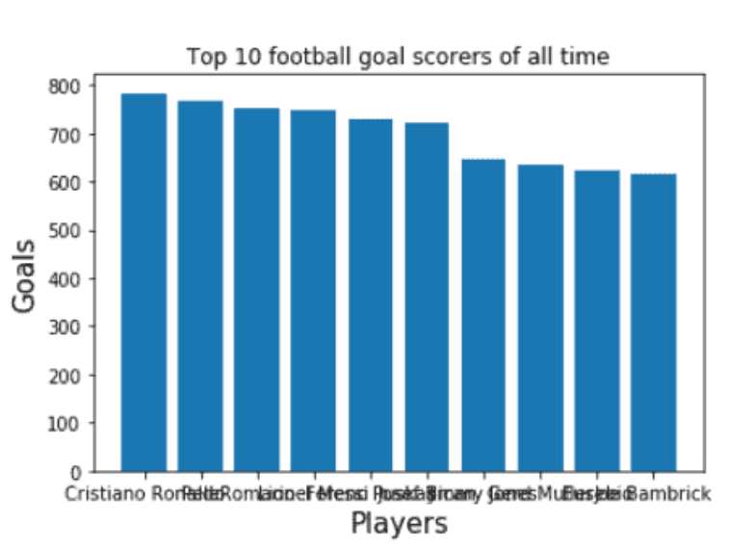
Visual example of bar graph in matplotlib
Note that this is NOT the final representation of the bar graph.
There are things that can be done to fix the graph.

Slide 6
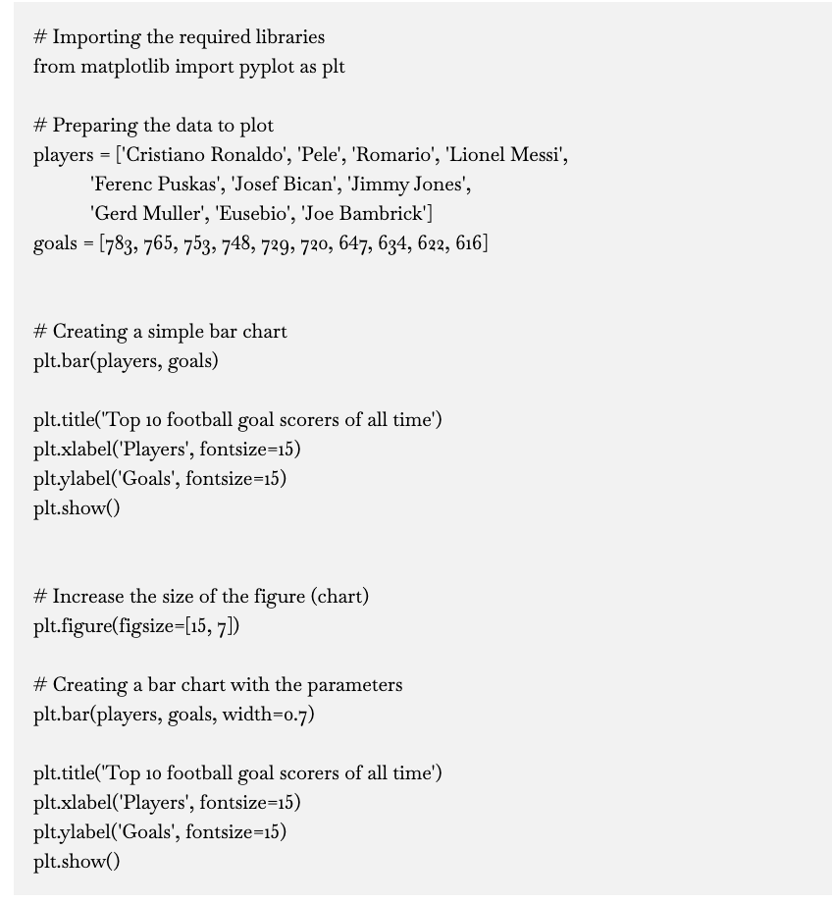
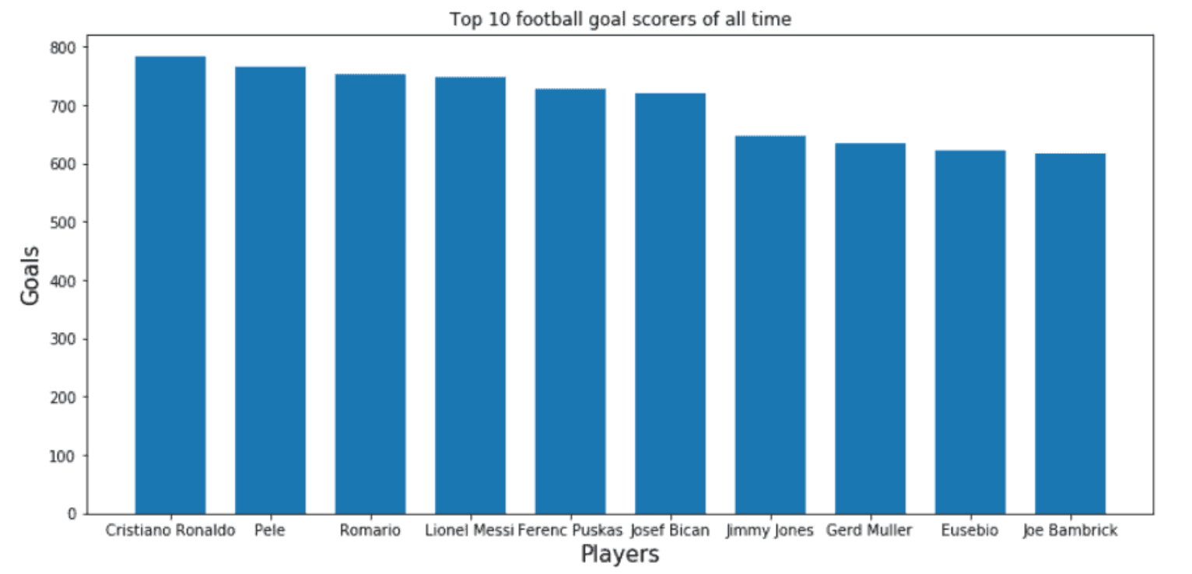
Visual example of bar graph
This is the same bar graph but with a fixed sized.
Along with the code.

Slide 7
Closer look at the code

Slide 8

Conclusion
Bar graphs is one of the ways data can be displayed.
Matplotlib is one of the ways to create a bar graph.
Depending on how the code is entered can determine the output for the bar graph created.

Slide 9
References
https://chartio.com/learn/charts/bar-chart-complete-guide/
https://www.investopedia.com/terms/b/bar-graph.asp
https://pythonguides.com/matplotlib-plot-bar-chart/
https://matplotlib.org/

